Slide 1

Eclipse Dataspace Connector – How to build Data Spaces
Markus Spiekermann Head of Department Data Business, Fraunhofer ISST Project Lead of Eclipse Dataspace Connector

Slide 2
Introduction
Data Spaces
Business Ecosystems
Eclipse Dataspace Connector
Key Takeaways

Slide 3
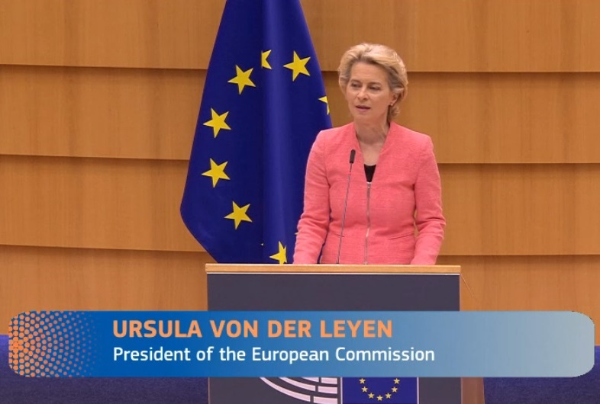
Motivation
»A real data economy, on the other hand, would be a powerful engine for innovation and new jobs. And this is why we need to secure this data for Europe and make it widely accessible. We need common data spaces - for example, in the energy or healthcare sectors. This will support innovation ecosystems in which universities, companies and researchers can access and collaborate on data. And it is why we will build a European cloud as part of NextGenerationEU - based on GaiaX.«

Slide 4
Change of Data Exchange and Sharing
C
C
B
C
C
C
C
C
C
H
C
C
B
I
C
C
I
Bilateral data exchange
Closed group data exchange
Open and dynamic data exchange

Slide 5
Data Spaces

Slide 6
What does a Data Space bring to the Table?
VALUES & FRAMEWORK FOR INNOVATION
Essential Services
Design Principles
Identity Management
Connectivity
Logging
ENTERPRISE/DIGITAL ECOSYSTEM (using EU standards)
European values
Secure and trusted
Easy-to-use
Federated, neutral
Vendor-agnostic
Cataloging
Policy Management
Commerce
SERVICE PLATFORMS
Basic Data Services
Broker, auditability
Transaction services
Quality scoring
DATA SHARING
Need for Action
Micro-payment services
Data Usage Control
…
CLOUD/EDGE
Implement technologies and governance for data spaces that enable and ensure transparency and data sovereignty, as end-to-end control by the data provider over the use of its data across corporate boundaries.
Interoperability Services
Data connector services
Encryption services
INFRASTRUCTURE
App Store
…
…
Data Governance/ Privacy
Platform access, antitrust
…

Slide 7


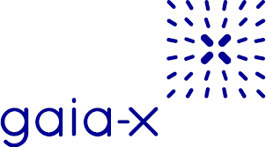

Landscape of Architectures and Services
GXFS-DE
GXFS-FR
Coordinated by
And others to follow…

Slide 8
Business Ecosystems

Slide 9




Business Ecosystems
Cluster organizations from various interests (e.g. domain)
Including service provider and operating companies
Enable collaboration for innovation and business models
Elaborate on future requirements and challenges to be addressed
Define common governance rules with democratic structures
Require openness for new participants and technology
Adapts the concepts of data spaces and their reference architectures
Images from freepik.com by tawatchai07 and aleksandarlittlewolf

Slide 10

Mobility Data Space
Initiated by the German federal government’s “Concerted Action on Mobility” committee in 2019
Data sharing community to build the future of mobility
Promotes forward-looking mobility services
Adapt the IDS RAM and available open source implementations of components
More than 200 stakeholders of German mobility landscape, science, business and government
20+ use cases that were presented on the ITS Worldcongress 2021
Productive operation planed from early 2022

Slide 11

Catena-X Automotive Network
Founding of Catena-X Automotive Network e.V. took place on 07.05.2021.
Alliance for secure and standardized data exchange along the automotive value chain
Offer network and technologies for collaboration and innovation
Ensure the economic viability of all network partners
Connect to cross-industry networks “built a Gaia-X compliant IDS-system”
Technical components and services incl. transfer and scale out
Initial use cases, e.g. Traceability, CO₂ Footprint, Circular Economy, Demand and Capacity Mgt.
Consortium of Industry, technology and platform experts

Slide 12
Implications of Ecosystems and Data Spaces
C
C
C
C
C
H
H
C
C
C
C
C
I
I
C
C

Slide 13
New challenges arise!
Different architectures and implementations for data space services
Organizations participate in various data spaces
Connection and interoperability with multiple data spaces
Identity across multiple jurisdictions
Catena-X, Mobility Data Space, and other initiatives present new data sharing challenges
Support for data flow and transfer protocols to handle diverse data types
Push, Streaming, Large Volumes, Realtime
Cataloging across many providers
Policy management that traverses multiple infrastructure layers
Need for extensibility and modularity to accommodate diverse needs and use cases

Slide 14
Eclipse Dataspace Connector

Slide 15
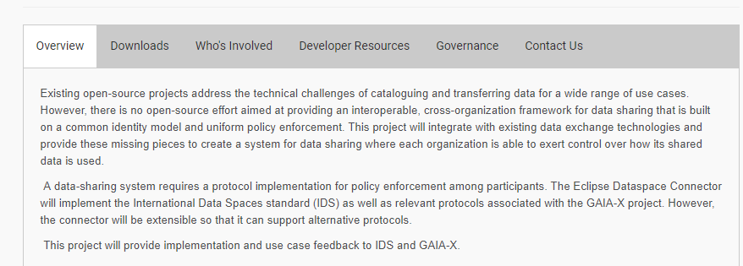
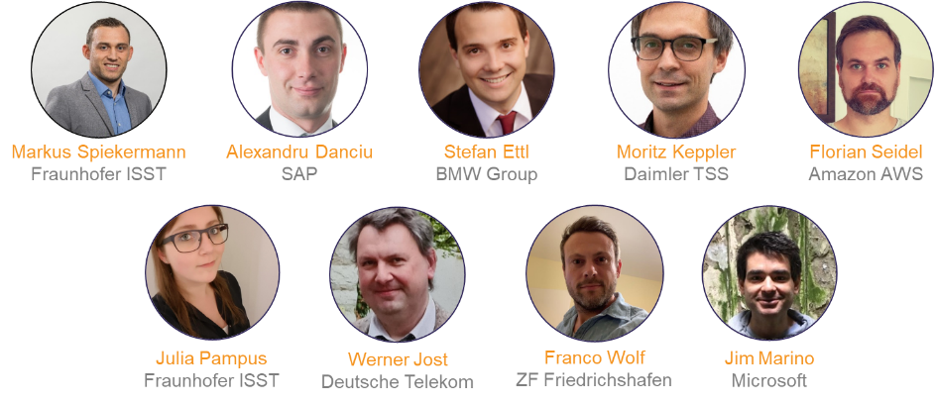
Eclipse Dataspace Connector

Slide 16
Features
Based on a simple modularity system
Separate control and data planes
System is asynchronous and highly available
Transfer processes are fully auditable
Eliminate single points of failure
Cloud aware policy enforcement and projection
System security

Slide 17
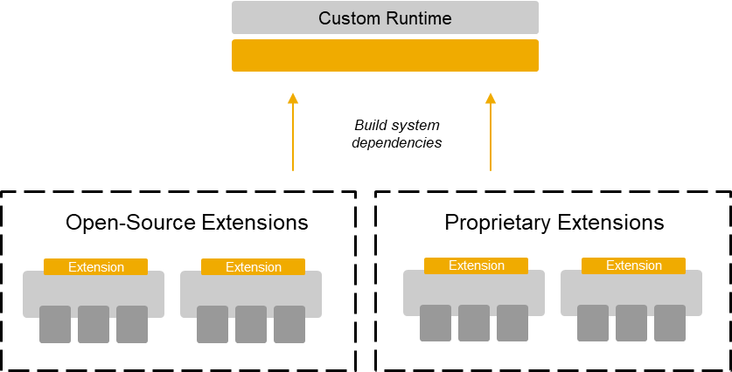
The Connector is a Coordinator
Modules are assembled into a runtime
Data cataloging handled by external system
e.g., Apache Atlas
Modularity allows this to be substituted
Data transfer and storage performed out of band
Modularity allows this to be substituted or augmented
Ability to add multiple transfer mechanisms to support diverse data types
Solves key aspects of how to handle streaming, large data transfer, and hyper scaling

Slide 18
The Connector is a Coordinator
Processes are modeled as persistent state machines
Nearly symmetric on the client connector and provider connector
Includes states for initiation, receipt, resource provisioning, transfer, and termination
State transitions happen asynchronously after a defined task is completed
For example, provisioning cloud storage for data
Tasks must be idempotent for reliability
Processes are persisted to a store
Can be a highly available database with geographic fail over
Or, as simple as an in memory Map
Provides a foundation for full observability and data audit
Metadata about each state is recorded
Observability can be achieved by correlating the process id with separate telemetry data

Slide 19
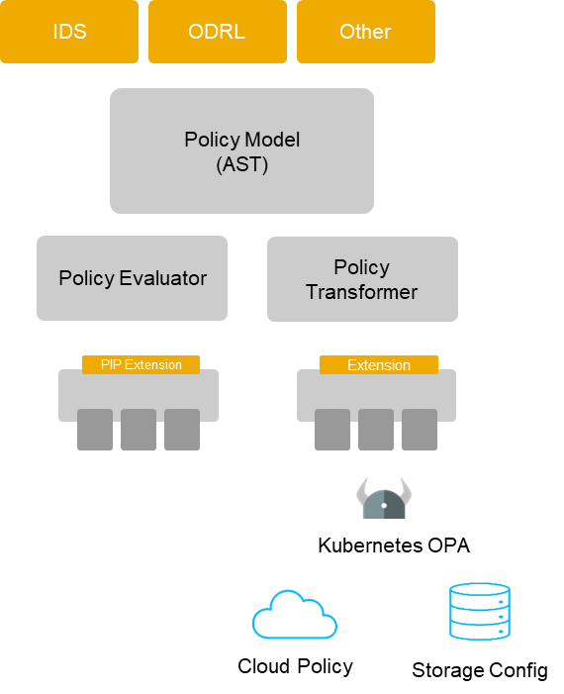
Cloud-Aware Policy Enforcement
Policy engine that is cloud aware
Not limited to the connector
Can be embedded in other processes
Horizontal and vertical enforcement
Parses policy syntax into an internal Policy Model AST
Evaluators and transformers to enforce policy
Evaluators can make policy decisions, e.g. is a connector authorized
Transformers can create and deploy policy to different levels
OPA, storage, etc.

Slide 20
Status-Quo and Roadmap
Official Eclipse project since June 2021
Initial contribution has been made, checked and approved by Eclipse Foundation
Actual results
Provide assets
OAuth2 and SSI authentication
Data flow, transfer and resource provision (via state machine, asynchronous and observable)
IDSA compliant self-description and contract offers
Provide samples for different use cases
What’s next (End of 2021)
Participation on the 2nd Gaia-X Hackathon 02/03 December
IDSA-based messaging and Control APIs
Policy negotiation and contract-aware data transfer
Release of EDC 0.0.1

Slide 21
Key takeaways
The EDC is completely FOSS supported by various companies
The EDC (through Eclipse Foundation) has clear and accepted governance structure and community processes
The EDC is more than connecting a database
The EDC manages data transfer and flow inclusive management of contract and policy management in cloud-native environments
The EDC follows a modular system to serve as facilitator
We have a good foundation already present on Github
There is still work to do
We welcome everyone to drive the idea and grow the community

Slide 22
Further information and contact
General project information:
https://projects.eclipse.org/projects/technology.dsconnector​
Github-Repository:
https://github.com/eclipse-dataspaceconnector/DataSpaceConnector
Mailing list:
dsconnector-dev@eclipse.org
YT-Channel
https://www.youtube.com/channel/UCYmjEHtMSzycheBB4AeITHg

